Slide 1


April, 2023
Android
Tech Talks
Akın DEMİR
Android Developer

Slide 2
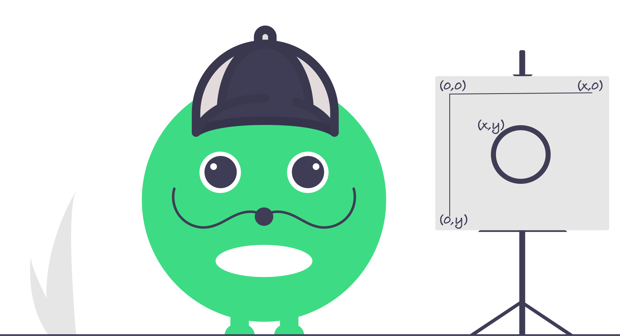
Custom Views
Drawing
with
Canvas API

Slide 3

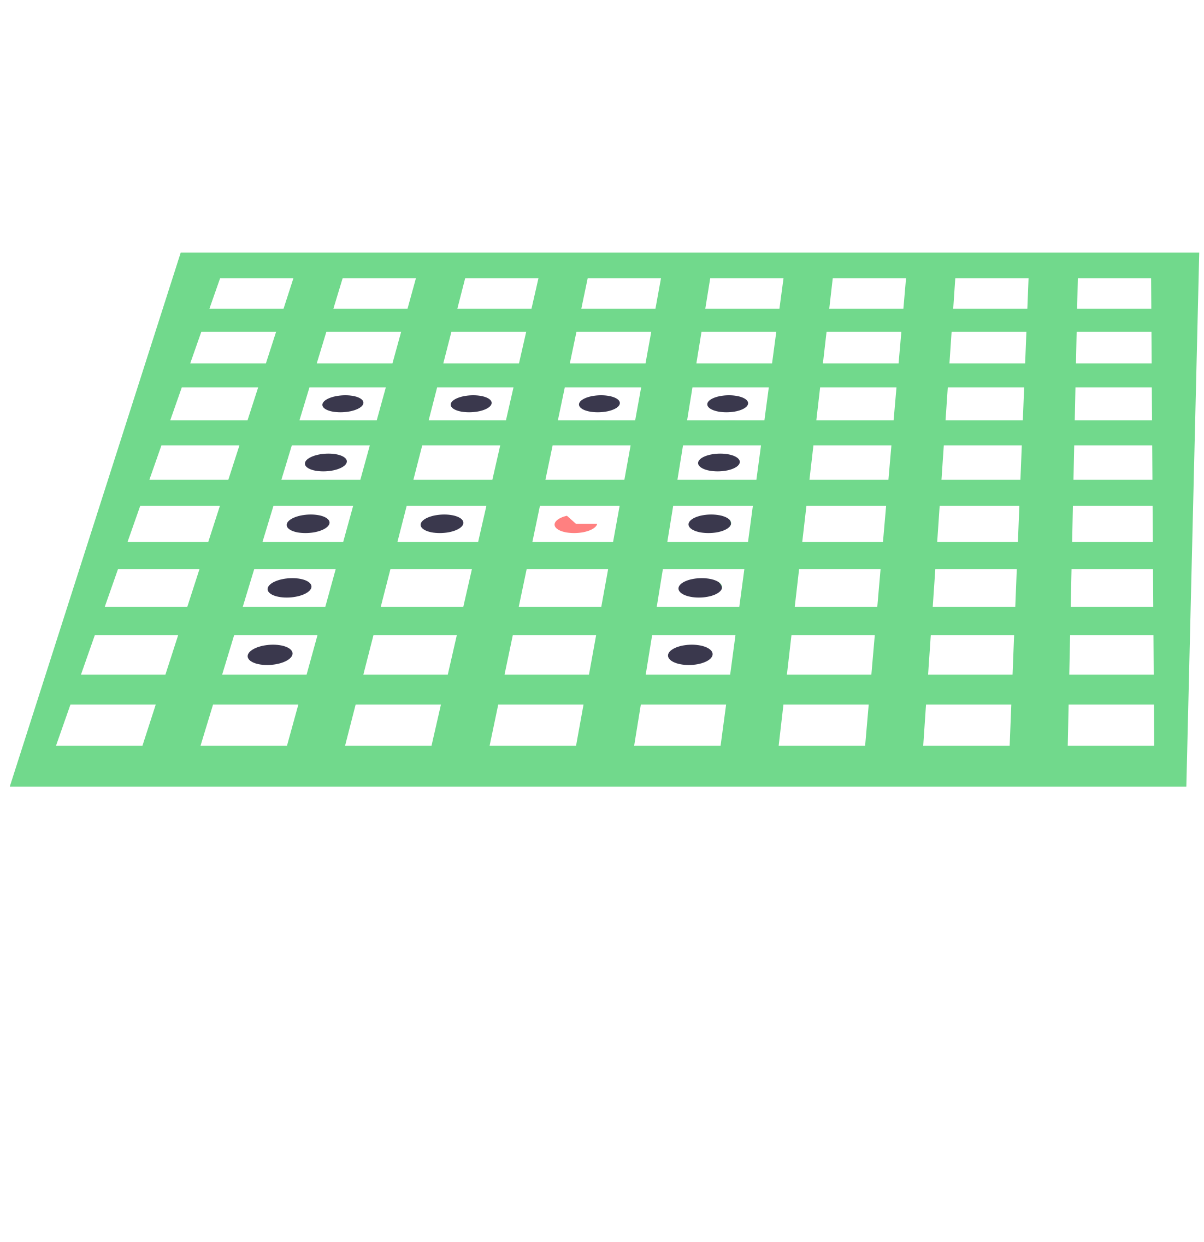
Drawing something
A paint
(colors & styles)
T
A drawing primitive
(Rect, Path, text, Bitmap, …)
bitmap()
rect ()
color()
A Canvas
host the draw() calls
to write into bitmap
arc()
circle()
text()
A Bitmap
to hold the pixels

Slide 4
What Canvas Provides?
Drawing
Clipping
Scaling
Rotating
Skewing
1
2
1
2
3
4
3
4
Translating
Hardware Acceleration
GPU
CPU

Slide 5
Drawing
Geometric Shapes
Colors
Text
Image
drawPoint()
drawARGB()
drawText()
drawBitmap()
drawPoints()
drawRGB()
drawTextOnPath()
drawPicture()
drawLine()
drawColor()
drawLines()
drawPaint()
drawPath()
drawRect()
drawRoundRect()
drawCircle()
drawOval()
drawArc()
drawVertices()

Slide 6
Drawing Geometric Shapes
drawPoint( )
drawPoints ()
canvas.drawPoint(
x,
y,
paint
)
val points = floatArrayOf(
x1, y1,
x2, y2,
x3, y3
)
canvas.drawPoints(points, paint)
(x₂, y₂)
(x, y)
(x₁, y₁)
(x₃, y₃)

Slide 7
Drawing Geometric Shapes
drawLine( )
drawLines ()
canvas.drawLine(
x_{s},y_{s},
x_{e},y_{e},
paint
)
val points = floatArrayOf(
x_{s1}, y_{s1},
x_{e1}, y_{e1}, x_{s2}, y_{s2},
x_{e2}, y_{e2}
)
canvas.drawPoints(points, paint)
(x_{s1}, y_{s1})
(x_{s2}, y_{s2})
(x_{s}, y_{s})
(x_{e}, y_{e})
(x_{e1}, y_{e1})
(x_{e2}, y_{e2})

Slide 8
Drawing Geometric Shapes
drawPath( )
val path = Path().apply {
moveTo(x_{s1}, y_{s1}) lineTo(x_{e1}, y_{e1})
lineTo(x_{e2}, y_{e2}) moveTo(x_{s2}, y_{s2}) lineTo(x_{e3}, y_{e3})
} canvas.drawPath(path, paint)
(x_{s1}, y_{s1})
(x_{e3}, y_{e3})
(x_{e2}, y_{e2})
(x_{e1}, y_{e1})
(x_{s2}, y_{s2})

Slide 9
Drawing Geometric Shapes
drawRect( )
drawRoundRect ()
canvas.drawRect(
Rect(left, top, right, bottom),
paint
)
canvas.drawRoundRect(
RectF(left, top, right, bottom),
r_{x},r_{y},
paint
)
(left, top)
r_{y}
r_{x}
(right, bottom)

Slide 10
Drawing Geometric Shapes
drawCircle( )
drawOval( )
canvas.drawCircle( X_{center}, Y_{center}, radius, paint
)
canvas.drawOval(
rectF,
paint
)
(X_{center}, Y_{center})
radius

Slide 11

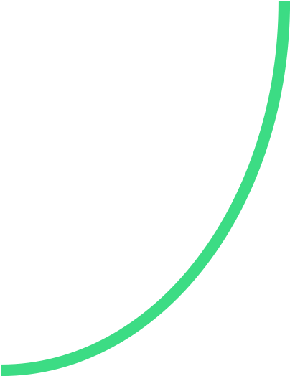

Drawing Geometric Shapes
drawArc( )
canvas.drawArc(
rect,
startAngle, sweepAngle,
useCenter,
paint
)
useCenter=true
useCenter=false
useCenter=false
startº
sweepº

Slide 12
Drawing Colors
drawColor( )
drawARGB( )
canvas.drawColor(
context.getColor(R.color.color1)
)
canvas.drawARGB(
alpha, red, green, blue
)
#3CDC84
(125, 60,220,132)

Slide 13
Drawing Colors
drawRGB( )
drawPaint( )
canvas.drawRGB(
red, green, blue
)
canvas.drawPaint(
paint
)
(60,220,132)
(LinearGradient)

Slide 14

Drawing Texts
drawText( )
drawTextOnPath( )
canvas.drawText(
text, x, y, paint
)
canvas.drawTextOnPath(
text, path h_{offset}, y_{offset}, paint
)
Canvas API Presentation
Canvas API Presentation

Slide 15
Drawing Texts
drawText( )
drawTextOnPath( )
canvas.drawText(
text, x, y, paint
)
canvas.drawTextOnPath(
text, path h_{offset}, y_{offset}, paint
)
Use StaticLayout to wrap texts.
Canvas API Presentation
Canvas API Presentation

Slide 16

Drawing Image
drawBitmap( )
drawPicture( )
canvas.drawBitmap(
bitmap, sourceRect, destRect, paint
)
canvas.drawPicture(
picture
)
destRect

Slide 17
To be continued
Teşekkürler,

